Slide 1
Simulation and Modeling
CSE4131_CSE4132

Slide 2
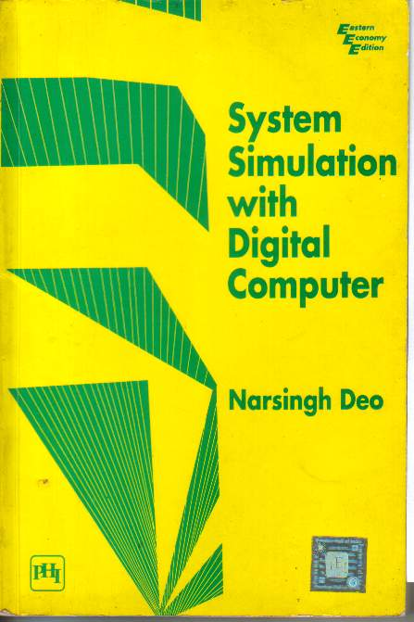
Recommended Book
System Simulation With Digital Computer
By Narshing Deo
Chapter 5: Simulation of a PERT network

Slide 3
What is PERT and CPM
PERT
Program Evaluation and Review Technique
CPM
Critical Path Method
Before 1950 … no effective formal method … planning and schedule large project
1957 -1959… PERT and CPM … great help…in this regards.

Slide 4
Network model of a project
Generally any … projects… can be thought of → number of separate activities
For example:
Building construction → Selection of site + decision of architecture + laying of foundation + etc
Due to technical reasons:
Some activities can not be started before some others are complete
Thus there will be some PRECEDENCE RELATIONSHIP
In addition, each activity require certain time → DURATION

Slide 5
Network model of a project
ACTIVITIES + PRECEDENCE + DURATION ➔ by means of an arrow diagram
Called: Activity Network or Activity Graph
Activities are shown as: directed lines or edges
Also called branches or arrows or arcs.
And the nodes represents the beginning and completion of Activities → called: Event or milestones in the project

Slide 6
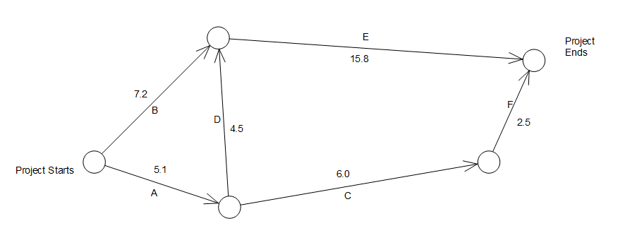
Network model of a project
An activity represented by edge (i,j)
can not be started before all activities leading to node i have been completed.
Let,… we have a project … 6 well defined, non overlapping individual jobs. → A,B,C,D,E,F
Restriction:
A must proceed C and D
B and D must proceed E
C must proceed F
i
j

Slide 7
Network model of a project
G
Dummy Activity:
Suppose we had an additional restriction→ F can’t be initiated before completion of B and D
Dummy activities are necessary → when existing activities are not sufficient enough to describe relationship
Duration=0

Slide 8
Network model of a project
In-degree → no of edge entering a node
Out Degree → no. of edge going out…
In-degree = 2
Out-degree = 0
Sink Node
In-degree = 2
Out-degree = 1
In-degree = 0
Out-degree = 2
Source Node
In-degree = 1
Out-degree = 2

Slide 9
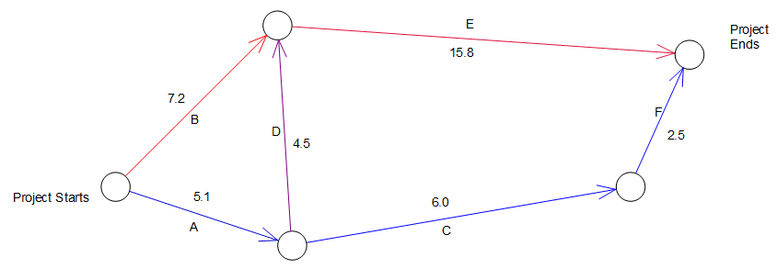
Analysis of activity network
Activity networks are analyzed by manager → optimizing the execution of project.
Path –A sequence of adjacent nodes from source to sink node is called :Path in a network
G (0)
ADE – is a path → length=5.1+4.5+15.8=25.4 days
ADGF– is a path →length=5.1+4.5+0+2.5 =12.1 days
ACF – is a path →length=5.1+6.0+2.5= 13.6 days
BGF – is a path →length=7.2+0+2.5= 9.7 days
BE – is a path →length=7.2+15.8= 23 days

Slide 10
Analysis of activity network
ADE – 25.4 days
ADGF –12.1 days
ACF – 13.6 days
BGF – 9.7 days
BE – 23 days
Critical Path → the longest path in a network…
Critical Activities → activities along with the critical path…
In a network there may be more than one critical path.
Use of critical path:
Find the project execution time
Any delay… execution of critical activities… delay the project

Slide 11
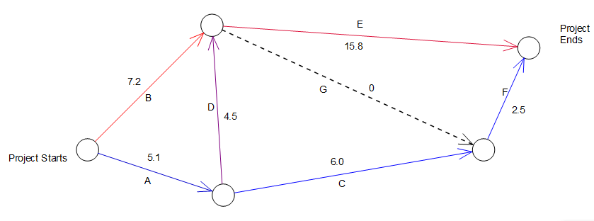
Topological Order
Topological Order → a list of activities … if no activity appears in the list before all of its predecessor have appeared.
A B C D E G F →Topological order
A B C D E F G →Not Topological order

Slide 12
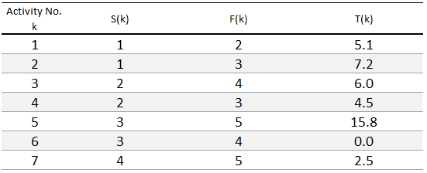
Finding Critical Path
Let, given activity network consist of :
N Activities (1,2….N)and
M Nodes (1,2…M)
Node 1 is the source node and M is the sink
In topological order
Starting Node of k^{th} activities
Finishing Node of k^{th} activities

Slide 13
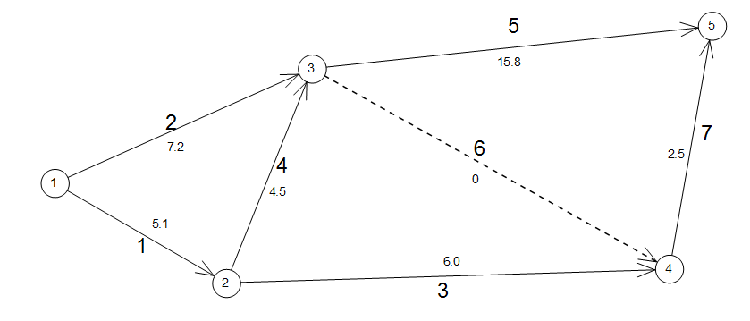
Finding Critical Path
Now find the critical path…

Slide 14
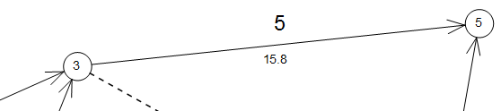
Finding Critical Path
K^{th} activity can’t begin …. Until
All activities terminating S(k) …. Completed
Earliest an activity k can begin … the last activity terminating in node S(k)
Let, EST (K) → earliest starting time for k^{th} activity
And EFT (k) → earliest finish time for k^{th} activity
Then
EFT(k) = EST(k) + T(k)

Slide 15
Finding Critical Path
All nodes → a milestone
A milestone i is said → Achieved → all terminating node to I completed
Let ENT(i) → earliest time when node i is achieved
Then
ENT(i) = Max { EFT (all activities terminating in i) } ----(5.2)
Since, EST (K) → earliest starting time for k^{th} activity
We can write EST(k)= ENT(S(k))

Slide 16
Forward Pass
ENT(i) → earliest time when node i is achieved
ENT(1)=0 Node 1’s achievement time=0
Since activity 1 begins @Node1
EST(1) = 0
EFT(1) = 0 + T(1)= 5.1
EFT(2) =0+T(2)= 7.2
Likewise, we compute all EFT’s for all activities originating @ Node1
ENT(i) = Max { EFT (all activities terminating in i) } -- ------- 5.2
Using this Eq. we can calculate ENT of next node.
ENT(2)=5.1 and ENT(3)=?

Slide 17
Forward Pass
For Nodes 1,2 and 3
ENT(1)=0
ENT(2)=5.1
ENT(3)=?
Calculate EST and EFT for some more activities
EST(4)=ENT(2)=5.1
EFT(4)=EST(4)+T(4)=5.1+4.5=9.6
ENT(3)= Max { EFT (all activities terminating in i) }
= Max{EFT(2), EFT(4)}= Max {7.2,9.6}
=9.6
This simple was possible because all activities was in topological order

Slide 18
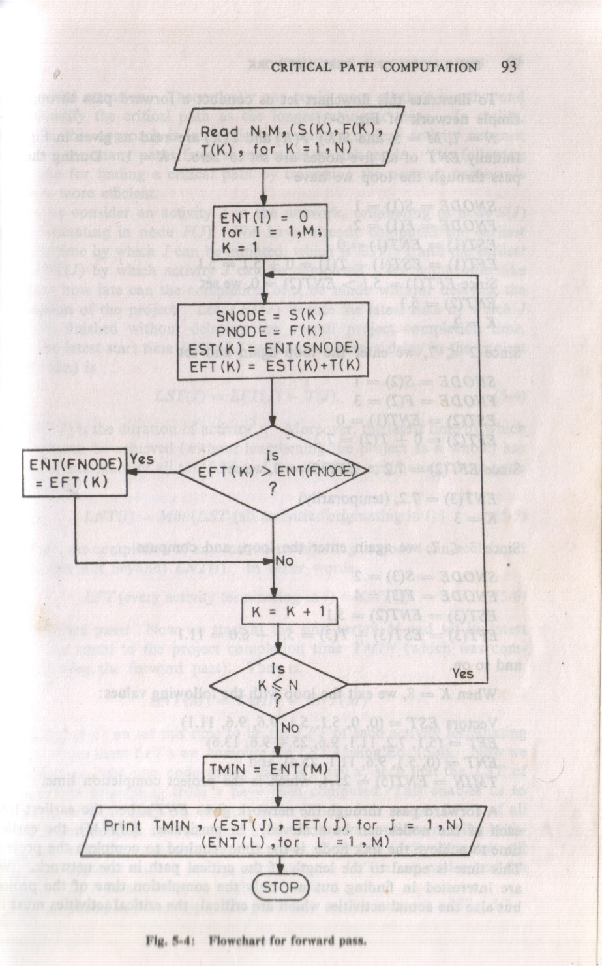
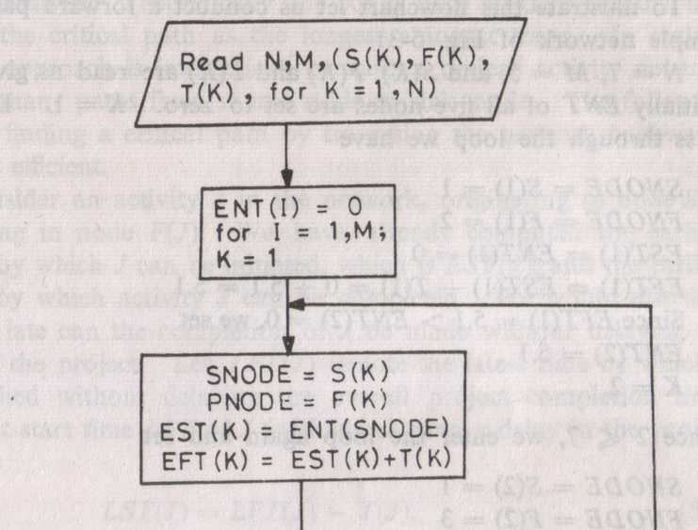
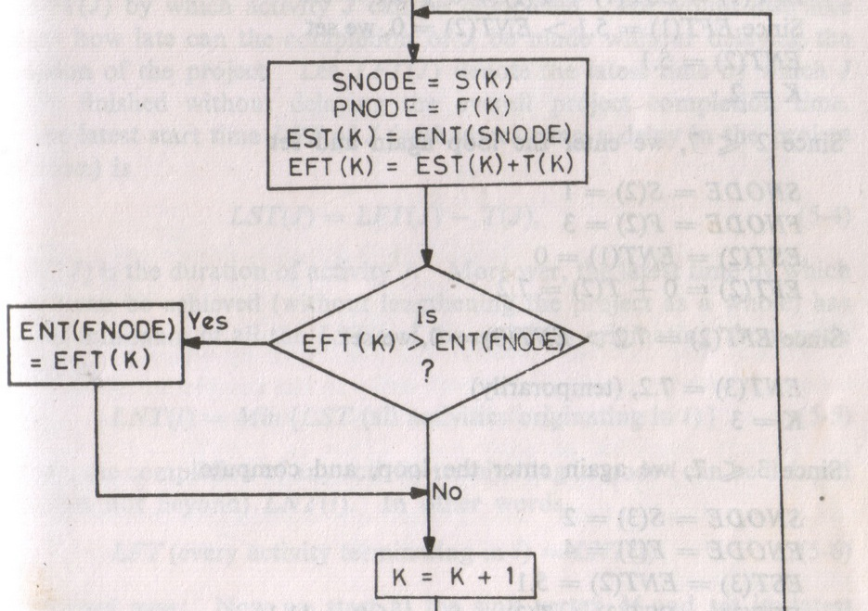
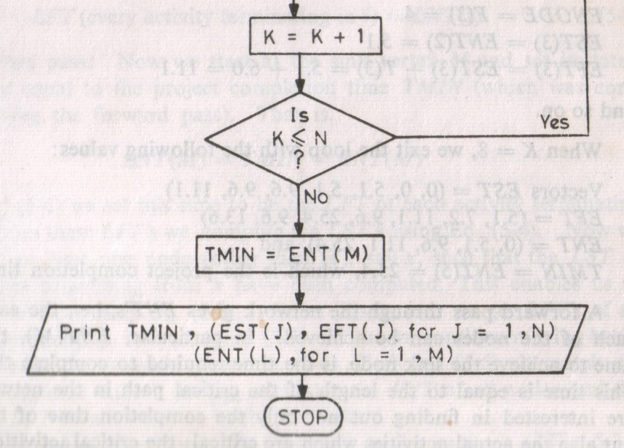
N Activities (1,2….N)and
M Nodes (1,2…M)
EST (K) → earliest starting time for k^{th} activity
EFT (k) → earliest finish time for k^{th} activity
ENT(i) = Max { EFT (all activities terminating in i) }

Slide 19
Programming Problem
Find Critical Path and Activities….

